Slide 1
Safe Lifting
Kacey Chamness, ATC
Rehab Industrial Outreach Coordinator

Slide 2
What is a Musculoskeletal Disorder (MSD’s)?
MSDs are defined as: Illnesses and injuries that affect one or more parts of the soft tissue and bones in the body. The parts of the musculoskeletal system are bones, muscles, tendons, ligaments, cartilage, and their associated nerves and blood vessels.
MSDs often involve the back, wrist, elbow, and/or shoulder, and occur when workers are exposed over time to MSD risk factors, such as awkward postures, forceful exertions, or repetitive motions
PREVENTION, BETTER THAN TREATMENT!

Slide 3
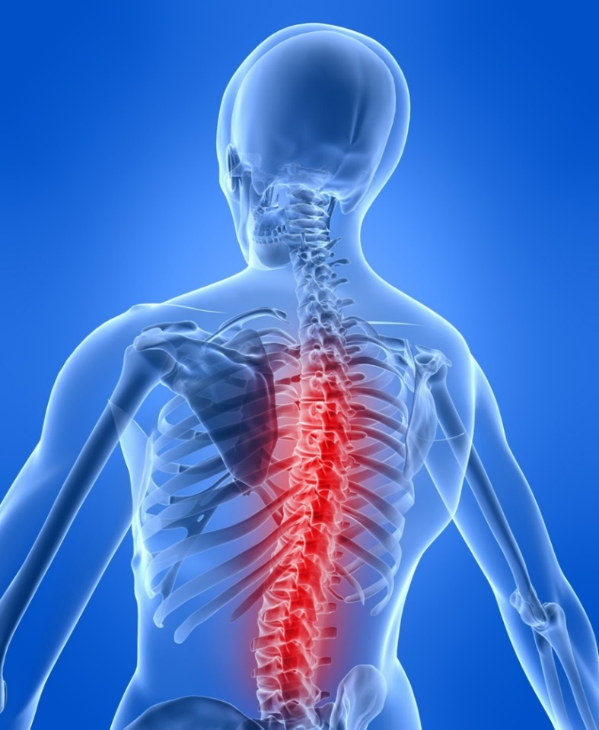
Guidelines for Safe Lifting
The Spine’s Basic Functions
Provides support
Protects the spinal cord
Provides flexibility for bending and rotating

Slide 4
Guidelines for Safe Lifting
Develop A Neutral Spine
Neutral Spine:
When the …….
Cervical (neck);
Thoracic (middle); and
Lumbar (lower) curves
are present and in good
alignment

Slide 5
Guidelines for Safe Lifting
Develop A Neutral Spine
Keep your spinal column aligned in its natural curves
Prop one foot up on a stool to reduce stress in your lower back
Simple stretches

Slide 6
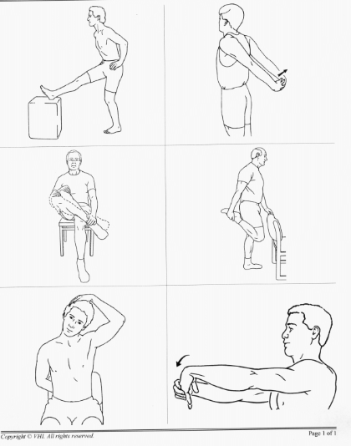

Slide 7
Guidelines for Safe Lifting
Preparation
Before lifting an object always……
Check the weight of the object
Make sure your muscles are warmed up
Make sure your spine is in a neutral position
Make sure your route is clear
Make sure the load will not shift

Slide 8
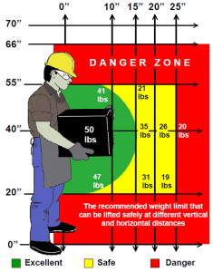
Guidelines for Safe Lifting
Power Zone
Reduce the movement arm as much as possible by reducing the load on the lower back and keeping the load close to the body
Carry object in your power zone when possible

Slide 9
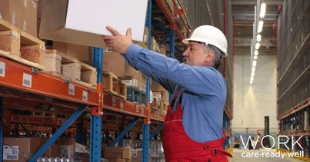
Guidelines for Safe Lifting
Preparation
Above your shoulders. Use a stool or ladder.

Slide 10
Guidelines for Safe Lifting
Techniques
Take a wide stance
Tighten your stomach muscles
Use smooth even motions
Use your legs to push up and lift the load
Do Not use your upper body or back muscles to lift!!!!!!
Make sure you are standing straight before you start walking

Slide 11
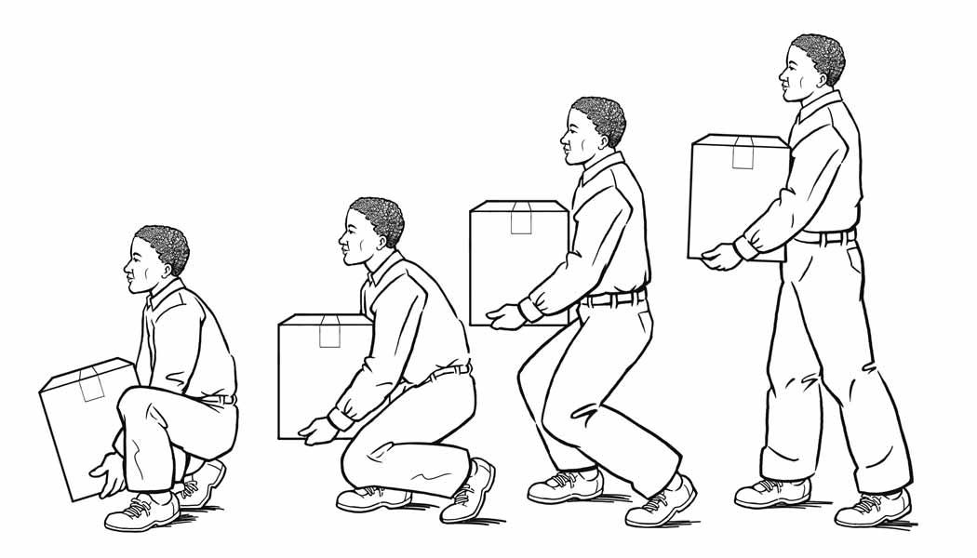
Hold load close to your body
Bend your knees, never your back
Lift with your knees

Slide 12
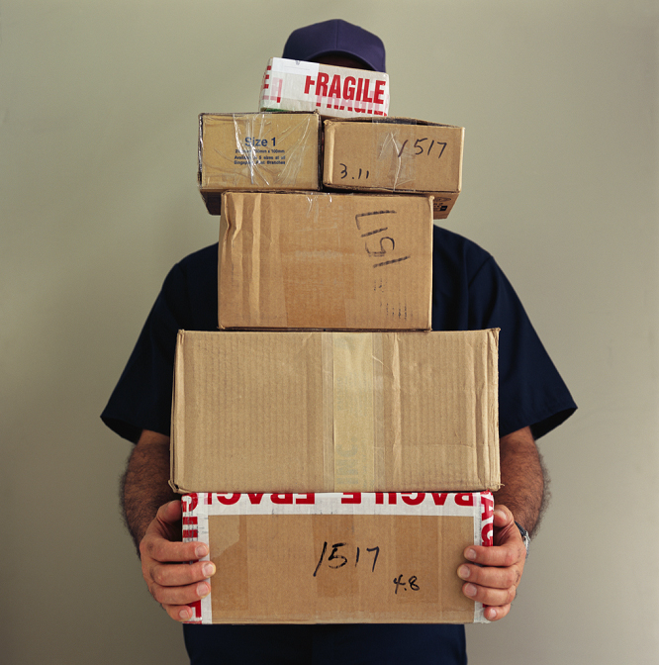
Guidelines for Safe Lifting
Techniques
Never carry anything you can’t see over or around
Team lift when the load is too much for one person
Don’t lift while reaching or stretching
Don’t lift from an uncomfortable posture
Never Fight to recover a dropped object (let it go)!
Move your feet instead of twisting

Slide 13
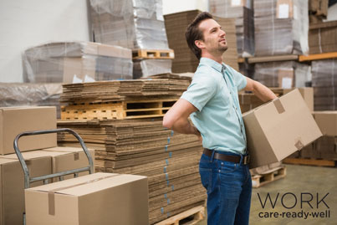
Large spinal
muscles are easily
strained with
twisting motions.

Slide 14
When you twist your
lower back you run the
risk of overstretching
or tearing any
of the large muscles or supporting ligaments around your spine.

Slide 15
This inflammation
can lead to a back spasm and it's the
back spasm that
can cause severe lower back pain

Slide 16
TWISTING

Slide 17
Are you lifting safely?

