Slide 1
Health Screenings in Food Pantries
Angie Bailey, Community Benefits Manger
April 11, 2019

Slide 2
Adults 18 and older can be screened:
Fasting Blood Glucose
Blood Pressure
Total Cholesterol
LDL
HDL
Triglycerides
Body Mass Index (Height and Weight)
Educational information can be provided as space allows.

Slide 3
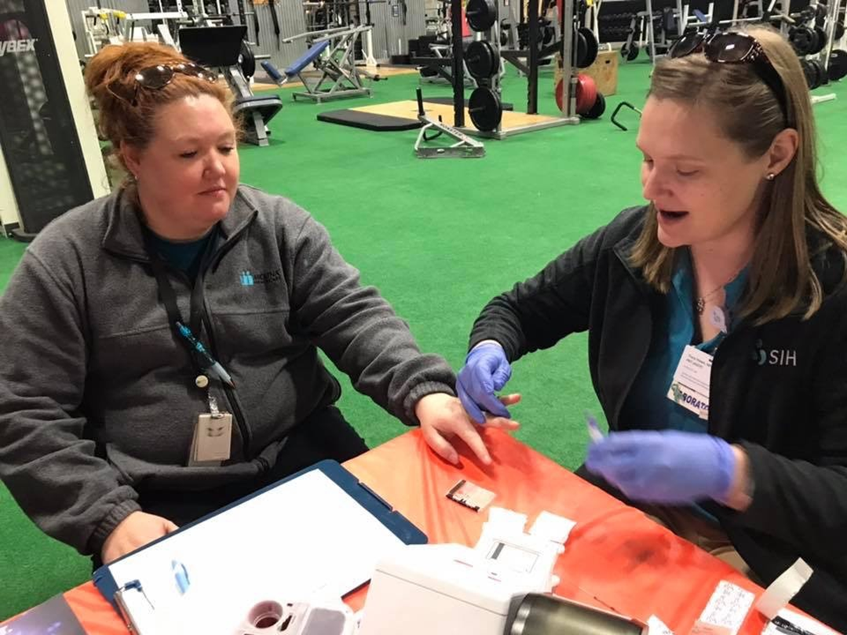
Food Pantry Screening Request Form

Slide 6
QUESTIONS?

