Slide 1
Southern Illinois Food Pantry Network
January 23, 2019

Slide 2
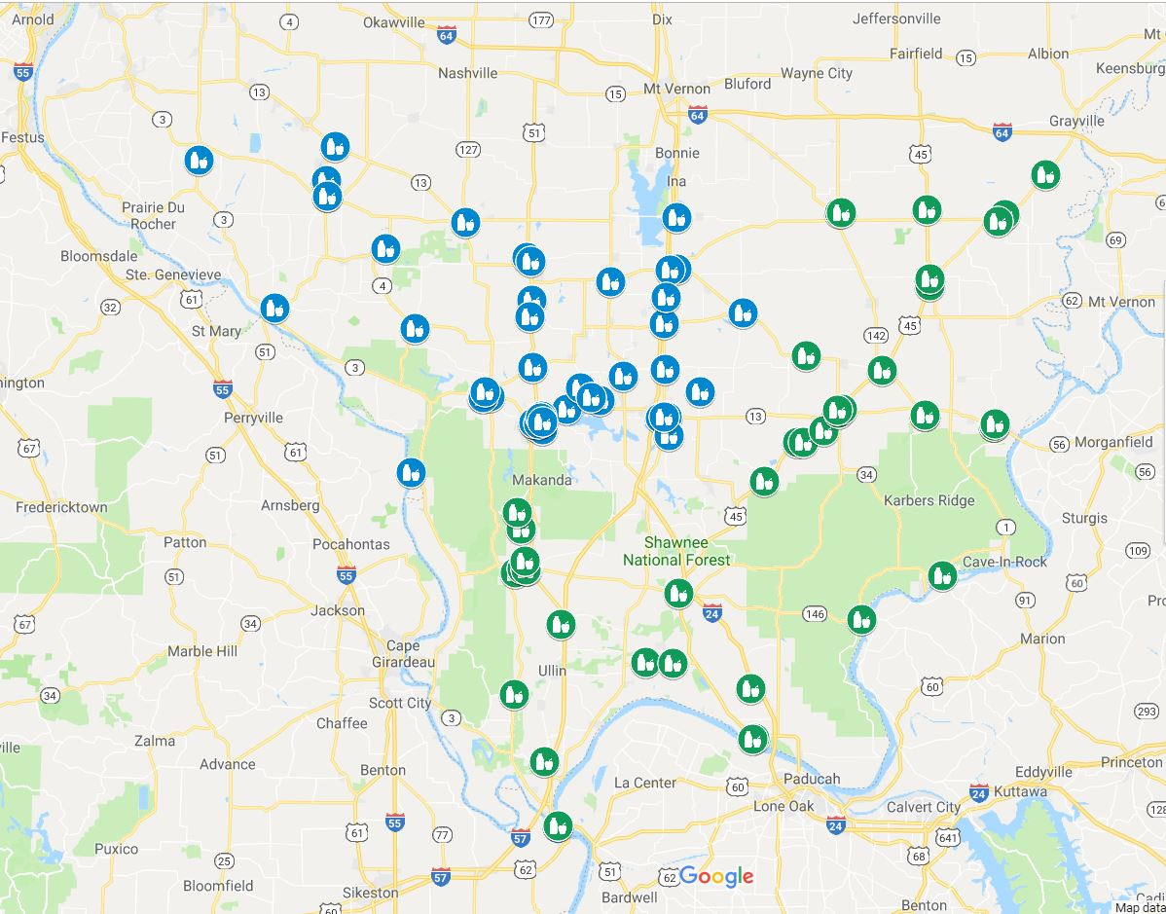
Who We Are, Where We’re From!

Slide 3
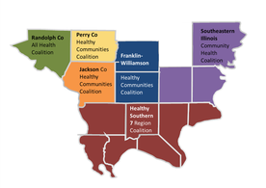
Working Together! -Angie Bailey

Slide 4
Organizational Chart
Steering Committee Members
SIH
Local Health Depts.
SIU School of Medicine
SIU SOM – Center for Rural Health & SSD

Slide 5
Focus of Programming

Slide 6
HSIDN.ORG

Slide 7
Personal Safety & Conflict De-Escalation Strategies - Nathan Cherry

Slide 8
Advocacy – Supporting Your Case -Michelle McLernon
Evidence Matters
Some Data is Collected and Shared
USDA
https://www.ers.usda.gov/topics/food-nutrition-assistance/food-security-in-the-us/
America for Hunger – Food Insecurity
Illinois https://www.feedingamerica.org/hunger-in-america/illinois
County data https://www.feedingamerica.org/sites/default/files/research/map-the-meal-gap/2016/child/IL_AllCounties_CDs_CFI_2016.pdf
Some Data We Must Collect Ourselves

Slide 9
What Hunger Looks Like in Illinois - 2016
SNAP
in Illinois
https://www.feedingamerica.org/hunger-in-america/illinois

Slide 10
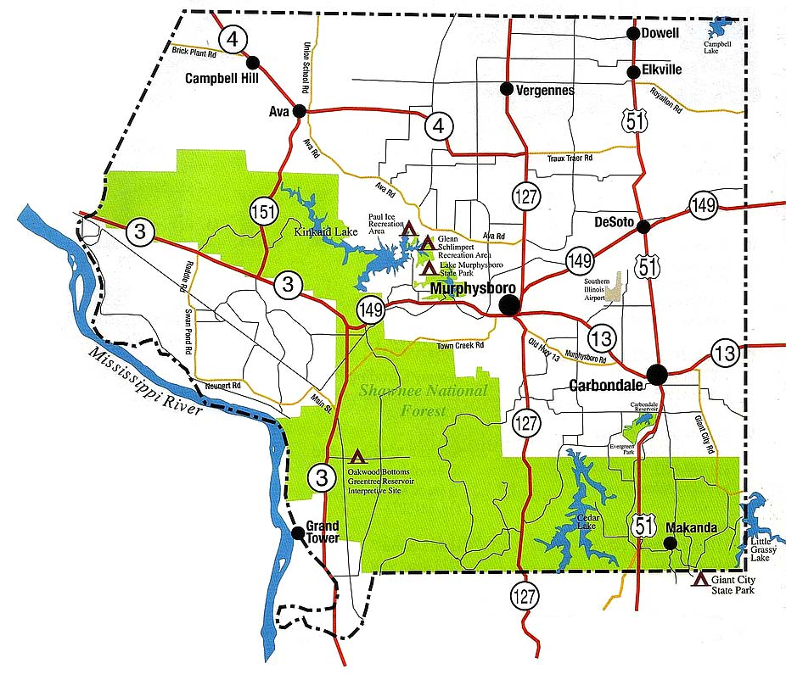
2016 Food Insecurity Rates in Jackson County
General Population: 18.6%
Population for residents under age 18: 10,703
Child Food Insecurity Rate: 19.6%
Estimated Number of Children Who Are Food Insecure: 2,100
Food Insecure Children Likely Income-Eligible for Federal Nutrition Assistance: 77%
Food Insecure Children Likely NOT Income-Eligible for Federal Nutrition Assistance: 23%

Slide 11
Food Drive Study Update - Dawn Null

Slide 12
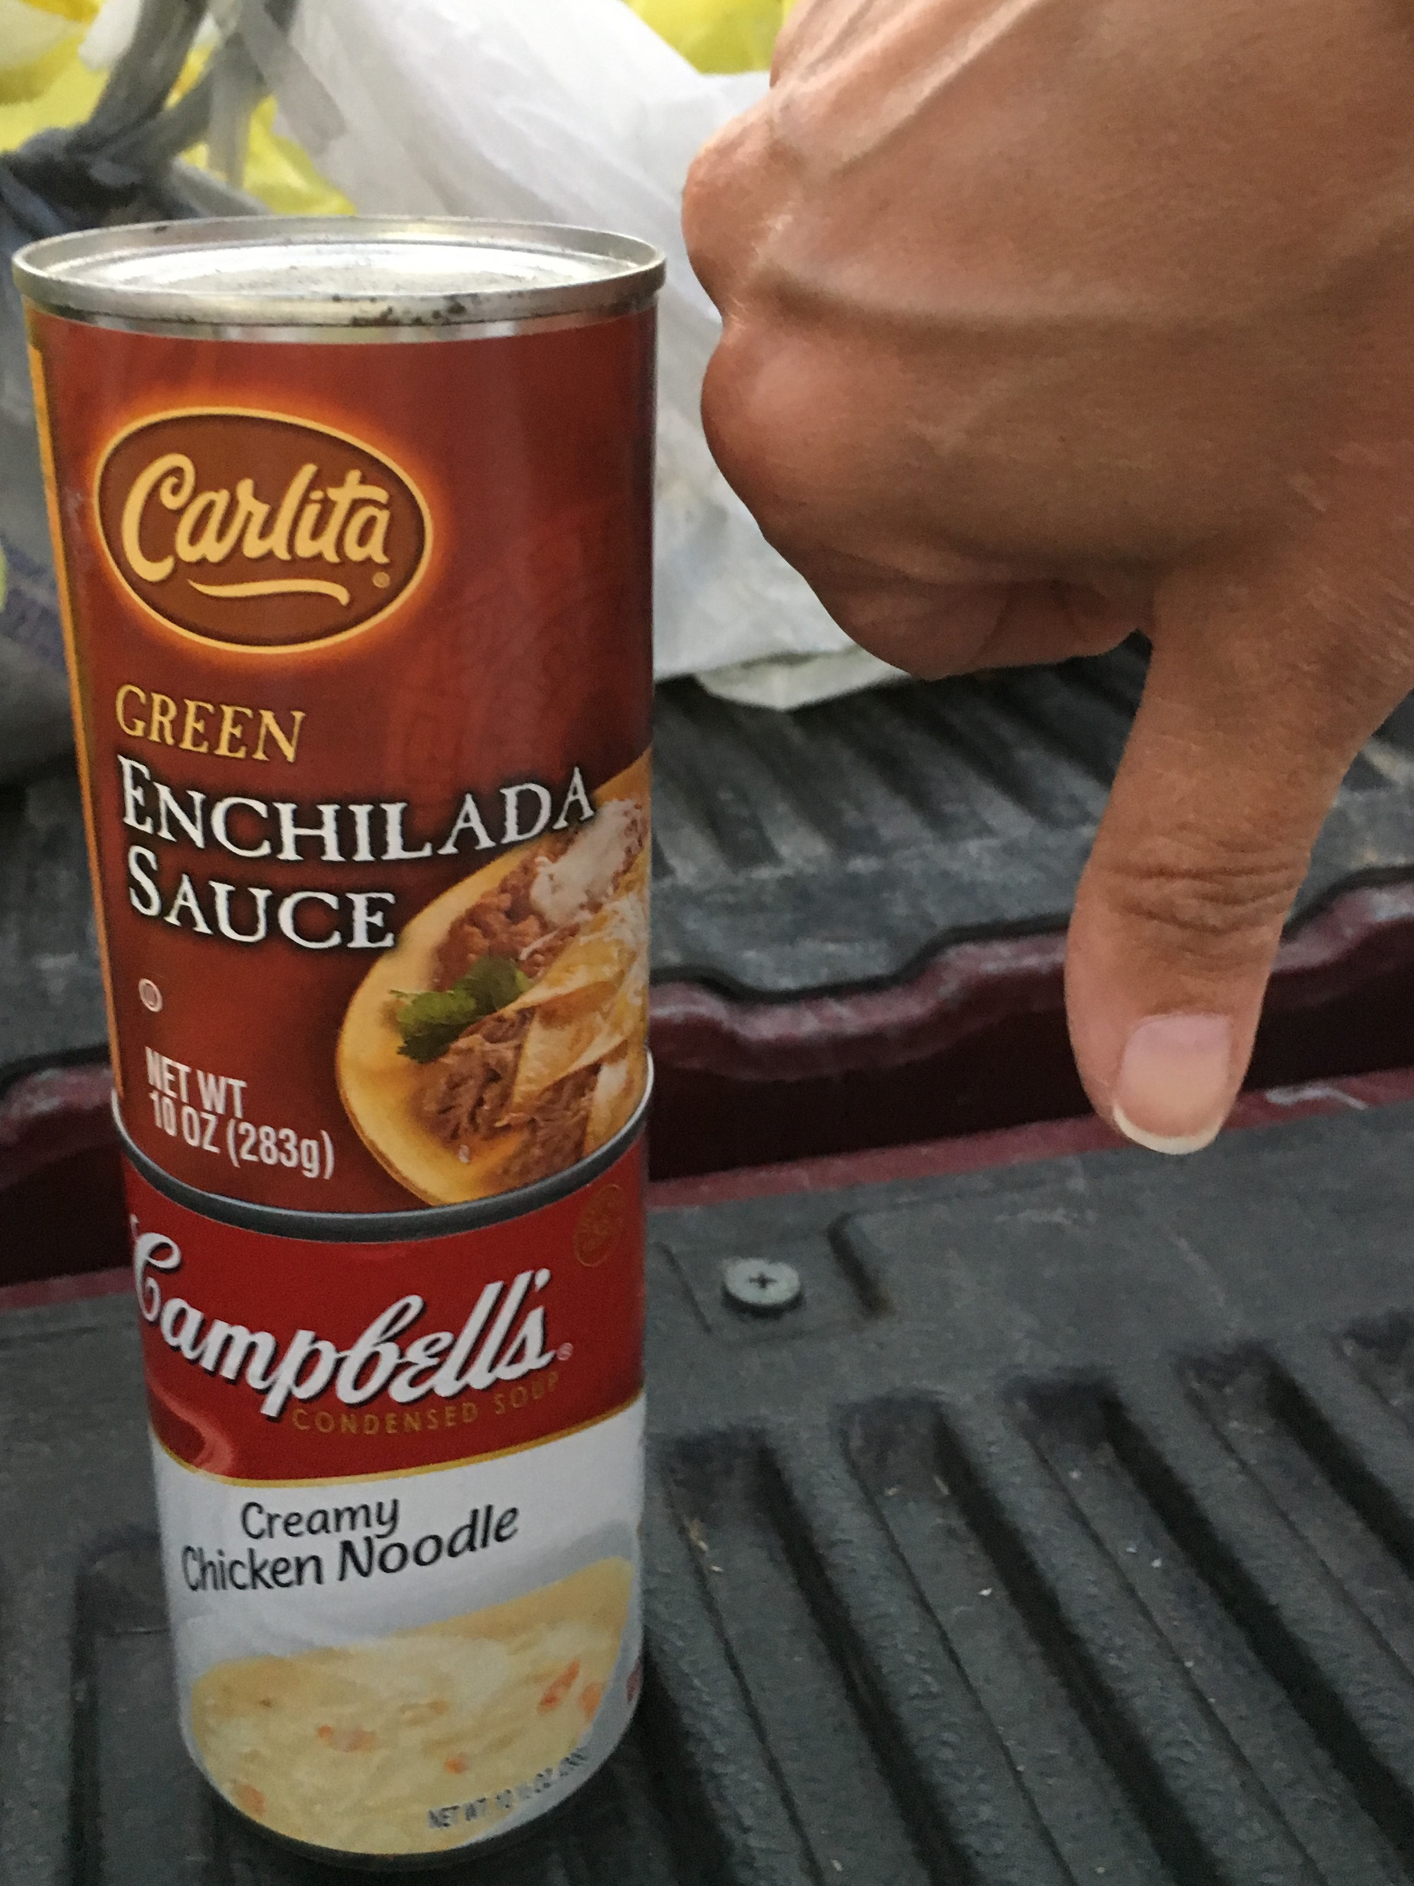

Slide 13
Foods to Encourage (F2E)
Foods to Encourage (F2E) is Feeding America’s approach to estimate the nutritional contributions of food categories in food banks’ inventories.
The product categories within F2E are consistently inclusive of food items that meet the USDA 2015 Dietary Guidelines for Americans, such as: fruits, vegetables, protein, dairy and whole grains.
To learn more, visit: https://hungerandhealth.feedingamerica.org/resource/foods-to-encourage-background/.

Slide 14
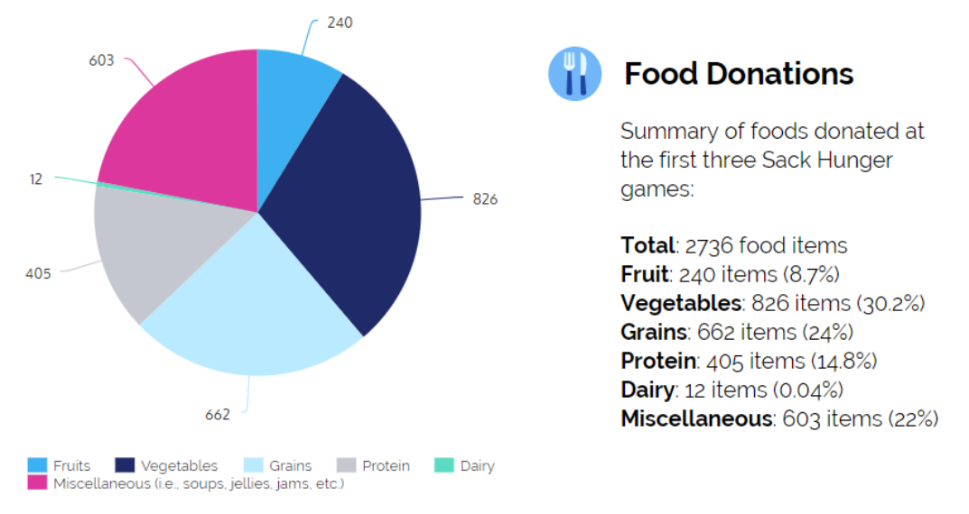

Slide 16
Branding the Southern Illinois Food Pantry Network
Southern Illinois
Food Pantry
Network
Southern Illinois
SOUTHERN
ILLINOIS
FOOD
PANTRY
NETWORK
Food Pantry
Network

Slide 17
And the winner is…
SOUTHERN
ILLINOIS
FOOD
PANTRY
NETWORK

Slide 18
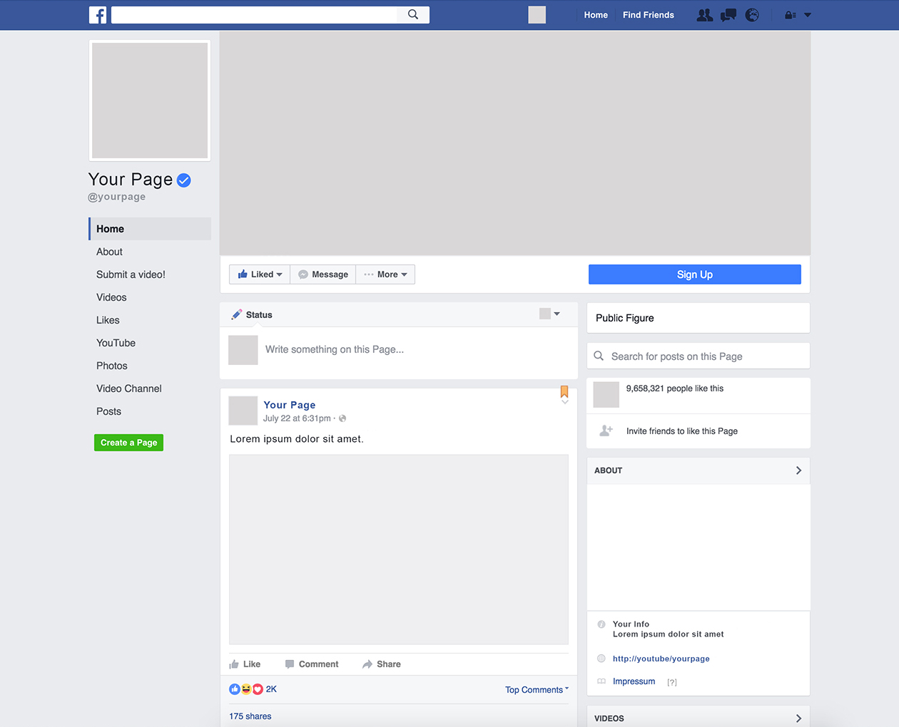
SOUTHERN
ILLINOIS
FOOD
PANTRY
NETWORK

Slide 19
Questions?

