Slide 1
SIFPN Manager Survey Results
SOUTHERN
ILLINOIS
FOOD
PANTRY
NETWORK
April 11, 2019

Slide 2
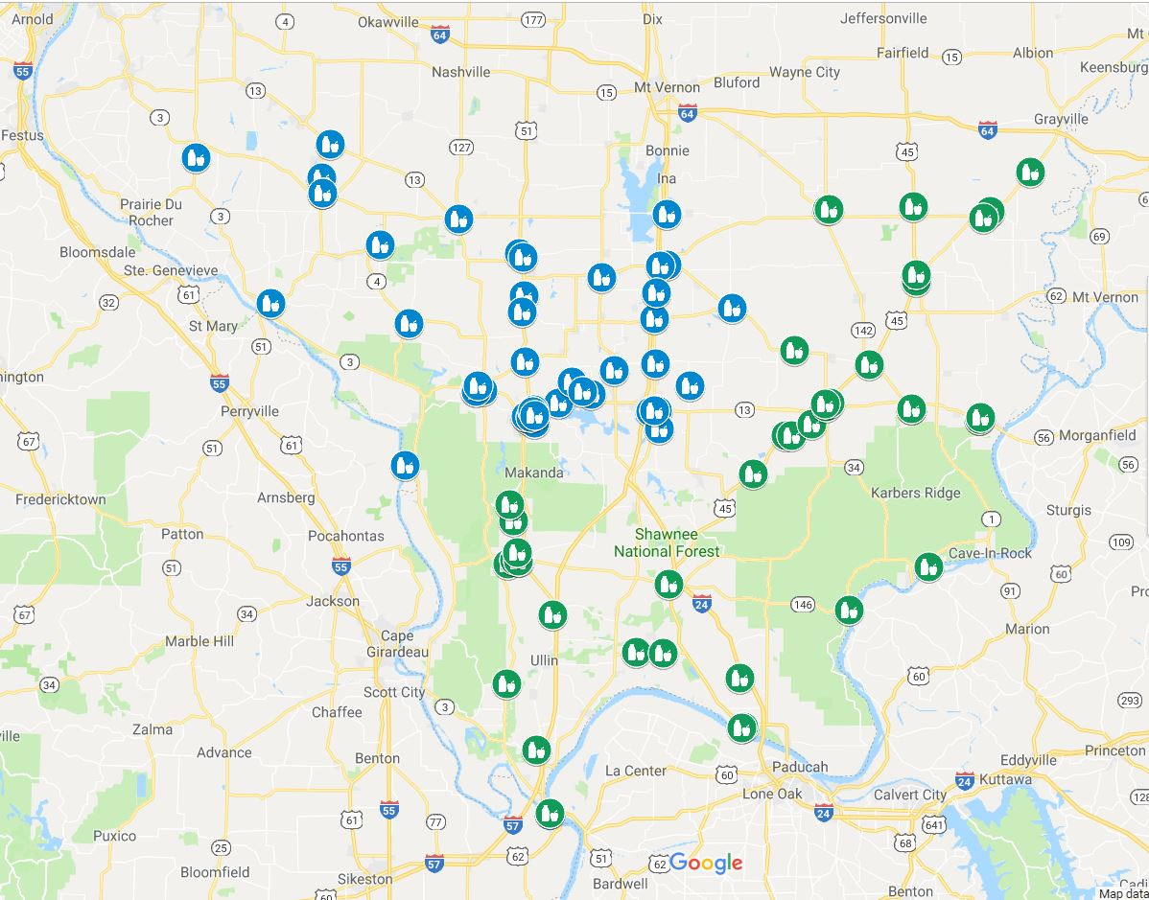
Who Responded
24 Respondents
Most open 1-2 days/week; mostly weekdays
Half are Faith-Based; Half Independent Non-Profit
Years in Operation – 1-40 years
Collectively,
1.6 million lbs distributed annually (n=6)
813 individuals served (12-5,000); 304 households (6-1,450)
Over 83% serve all populations
Notes:
Only one open on Sunday; 5 on Friday and 5 on Saturday; Over 70% have been open for 10 years or more; some serve only targeted populations (e.g., veterans, students, at-risk youth)

Slide 3
Food Sources

Slide 4
Staffing
Paid Staff
Volunteers
1.4 Average
22.4 hours/week
56% have at least one paid staff
Range: 1-7
15.9 (20.6) Average
21.4 hours/week
100% - All use volunteers
Range: 1- 50 (120)

Slide 5
Staff’s Abilities
Paid Staff
(n=13)
Volunteers
(n=23)

Slide 6
Happy Staff!

Slide 7
Workplace Safety

Slide 8
Administrative Support
Board of Directors
64% have one
Average membership: 6.8 members
Frequency of Meetings: Bi-weekly to Tri-annually

Slide 9
Physical Space
Space in Square Feet
Average: 1150
Range: 225-4000

Slide 10
Environmental Practices
*10% - 29% did not know if they had these practices; those who had them didn’t think they were very effective
Notes:
*10% - 29% did not know if they had these practices; those who had them didn’t think they were very effective

Slide 11
Physical Resources
Percent who indicated there was not enough of resource
35% 50% 33% 40%

Slide 12
Transportation
54% are owned by the pantry, 46% owned by staff
43% receive mileage; 57% are not reimbursed
85% reported availability of vehicle was good/excellent
79% said vehicles were in good/excellent condition
63% said they had good/ excellent access to backup vehicle

Slide 13
Office Technology
86% reported having enough office space
95% had enough equipment/technology

Slide 14
Distribution Model – Client Choice
Client choice is…

Slide 15
Distribution Time
Time Waiting Until Distribution
71% wait <10 minutes
29% wait 10-19 minutes
Time Taken for Distribution
72% take <10 minutes
19% take 10-14 minutes

Slide 16
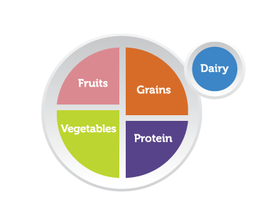
Distribution – Dietary Needs
Nearly 70% do NOT ask about dietary needs
Of the following offerings:
27% indicated they were good at providing nutrition information
27% indicated they were good at providing dietary alternatives
36% indicated they were good at providing complete food packages

Slide 17
Distribution Process
Welcoming Environment – 90%
Overall Distribution Process – 86%
Distribution Instructions to Clients – 86%
Oral Communication – 64%
Client Evaluation Process – 57%
Written Materials – 42%

Slide 18
Client Referrals

Slide 19
Communication to Public

Slide 20
Communication to Public

Slide 21
Financial Strategies

Slide 22
Financial Strategies

Slide 23
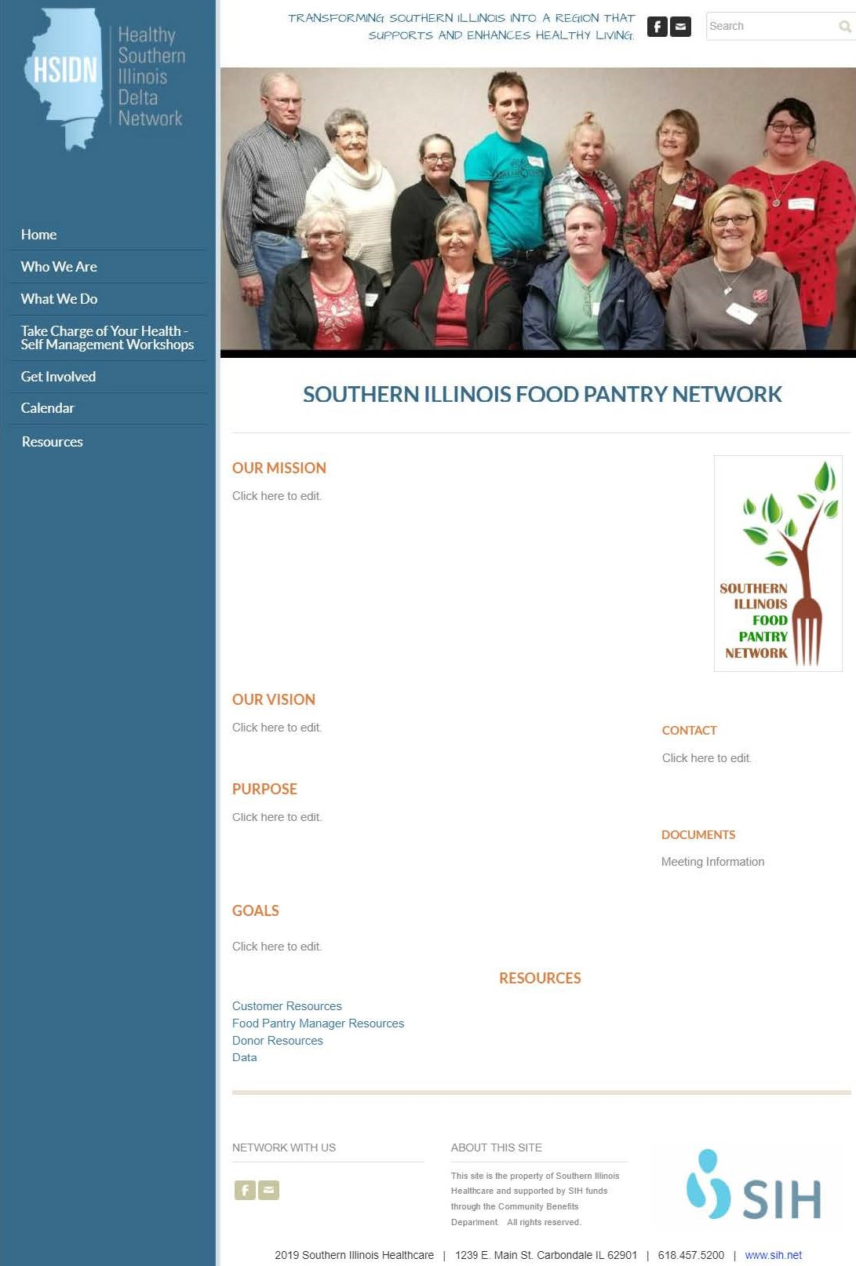

Slide 24
Questions?

Slide 25
Vision and Mission Statement
Vision – Picture of preferred future – it’s a statement of how the future will look if the organization fulfills its mission.
Mission – An overall purpose statement which describes what we do, for whom we do it, and the benefit.
MONTANA FOOD PANTRY NETWORK
Our mission is to end hunger in Montana through food acquisition and distribution, education and advocacy. Our vision is a Montana free from hunger where everyone has equal access to nutritious food.

Slide 26
SIFPN VISION
Transforming the lives of residents with food insecurity in southern Illinois communities.

Slide 27
MISSION
SIFPN is coming together to reduce hunger and improve the health and well-being of our communities through access to healthy and nutritious food, education, resources, and advocacy.

